Slide 1
Behavioral Science
Presented by: Reyoz Kumar Rayamajhi

Slide 2
Intro…….
The explanation given in classical theory about human beings were not satisfactory.
It was observed that the workers were not happy and satisfied with the economic incentives alone.
What is that the worker aspire from their organizations?
They began to investigate into human side of an organization.
They studied different factors associated with
The findings of these studies can be grouped into two categories:
Human relations approach( importance of the individual within the organization)
Behavior Science Approach( integrates the fields of psychology, sociology, and anthropology to explain the interpersonal relations and behavioral patterns of workers)

Slide 3
I) Human Relation Approach:
Human resource are the prime resources of an organization to achieve goals.
Researchers from Harvard university who conducted a series of studies between 1927 and 1932 among several group of workers at the Hawthorne plant of the Western Electric Company in Chicago.
HAWRHORNE EXPERIMENT: (Elton Mayo-{1880-1949}): effect of the physical environment , such as changes in the level of lighting in the working area, upon the productivity of workers.
Result were confusion:
Lighting = Output and
Ligthing = Output
Conclusion: the workers were highly motivated not by the degree of illumination provided but rather by their feelings of importance.

Slide 4
Findings:
Factors such as hours of work, wage incentives, etc. did not in themselves have an independent effect on employee efficiency.
Change in attitude of employees had significant effects on productivity than working conditions.
The “team” feeling contributed to increase in productivity.
The Interviewing Programme: (1600 employees)
The interviewers observed that social groups were being formed informally at the workplaces.
These informal groups were capable of exercising strong over the behavior of their individual members
Thus, highlighted the interrelationships among employees and their group organizations

Slide 5
Continue…
Bank Wiring Observation Room:
The purpose of this observation was to study the influence of informal groups on employees performance.
Positive response were found such as evolved their own codes of behavior, hierarchy of members, and standards of output.
All member are following these group standards and norms.
Thus, social system was found to be emerging in workplaces.
Findings:
The established the “ social man” theory of organization.
The management must have awareness and understanding of group functioning to improve output by improving relationship at work.

Slide 6
Continue..
These ideas were a fundamental shift away from classical organization theory.
The Hawthorne experiment , thus , placed new emphasis upon the social, psychological and physiological factor in the study work.
Behavioral Science Approach:
The behavioral scientist who have lasting impact on management thinking and practice were Abraham Maslow, Douglas McGregor, and Frederic Herzberg.

Slide 7
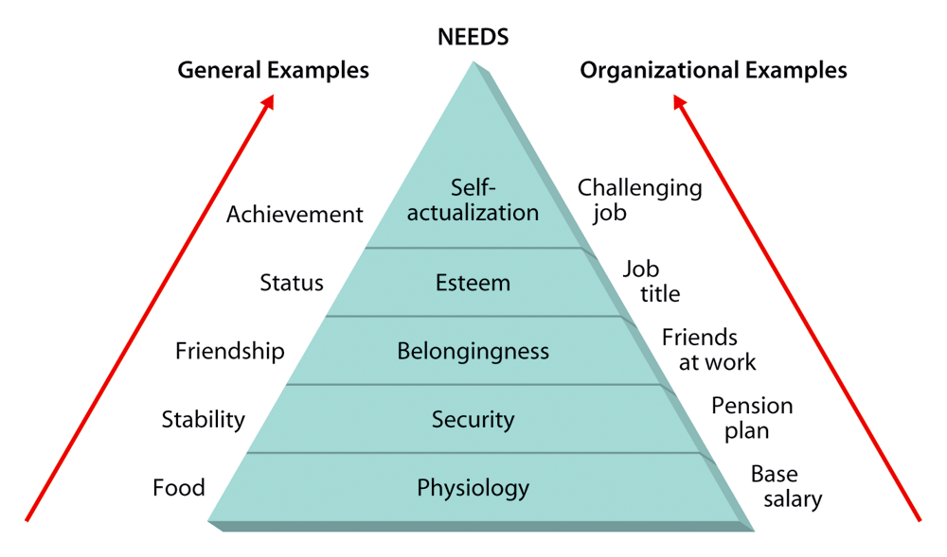
Abraham Maslow:
He was a psychologist, studied and analyzed human needs.
His work on human motivation is considered as vital significant to understand human behavior in organizations.
He classified human needs into 5 different catagories:

Slide 8
Continue..
According to him, as the lower level needs are satisfied, they are no longer motivating factors and the higher level needs become dominant.
However, a need at one level does not have to be completely satisfied before the next need emerges.
Very few people ever fully realize the fulfillment of higher level needs and become self – actualized.
Implication
Manager must recognize the need pattern of each worker.
Manager should also be aware of the fact that the well satisfied needs do not motivate.

Slide 9
McGregor’s Theories X and Y
Theory X: (Some traditional assumptions about people) | Theory Y: (Some modern assumption about people)
Most people dislike work, and they will avoid it when they can. | Work is a natural activity, like play or rest.
Most people must be coerced ad threatened with punishment before they will work. | People are capable of self – direction and self-committed to objectives.
Most people prefer to be directed. They avoid responsibility and have little ambition. They are interested only in security. | The average person can learn to both accept and seek responsibility. Many people in the general population have imagination, ingenuity, and creativity.

Slide 10
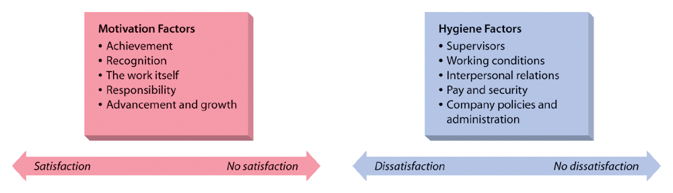
Fredrick Herzberg
Suggests that people’s satisfaction and dissatisfaction are influenced by two independent set of factors.
Can you name them?
  Motivation factors.
  Hygiene factors.
The following is a micro view of the Two-Factor theory:

Slide 11
Micro View of the Two-Factor Theory
Motivation factors:
  Achievement
  Recognition
  The work itself
  Responsibility
  Advancement and growth
Hygiene factors:
  Supervisors
  Working conditions
  Interpersonal relations
  Pay and security
  Company policies and administration
When hygiene factor are felt to be inadequate by workers, the factors as dissatisfies and they do not motivate employees to greater productivity.
On the other hand when Motivation factor are present , they create the conditions for motivation and higher productivity.

